Slide 1
App Dashboard
Made By Eli

Slide 2
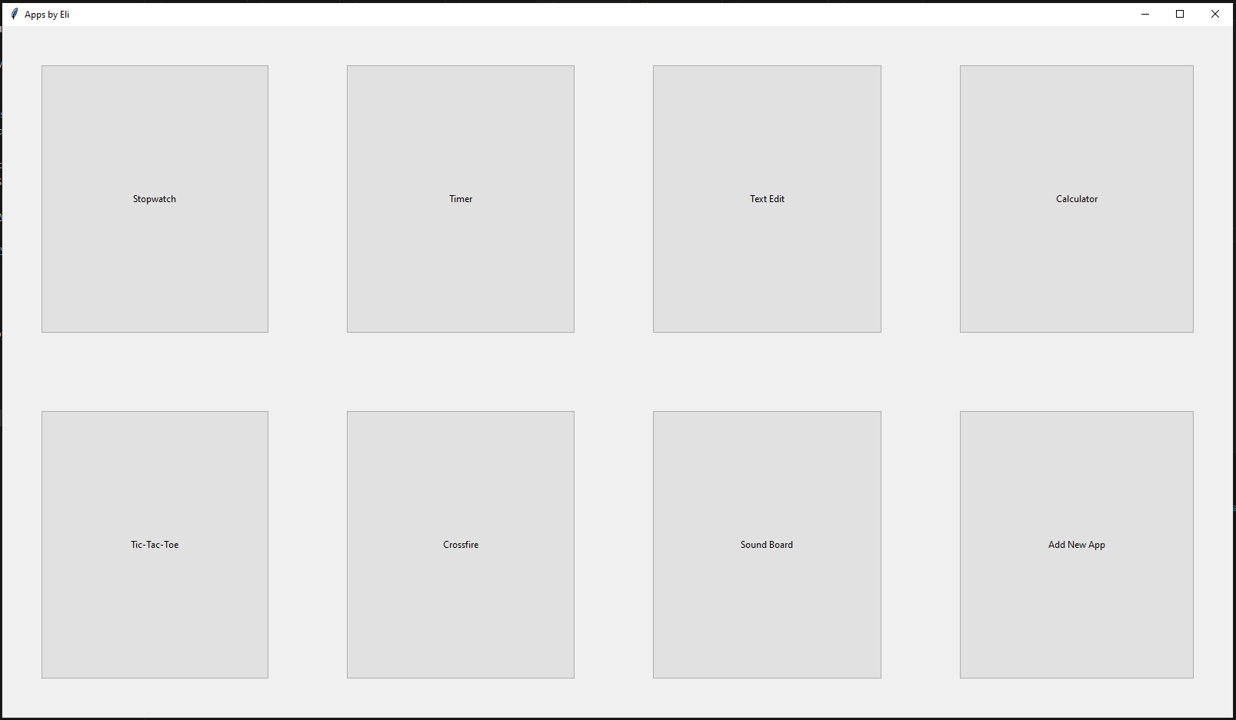
Main Menu
Allows you to select and open various applications and add new applications using the Add New App button

Slide 3
Apps

Slide 4
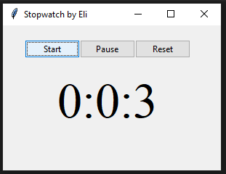
Stopwatch
A basic stopwatch application
Counts up every second
Functions
Start
Starts the stopwatch
Pause
Pauses the stopwatch
Reset
Resets and pauses the stopwatch
56 lines of code

Slide 5
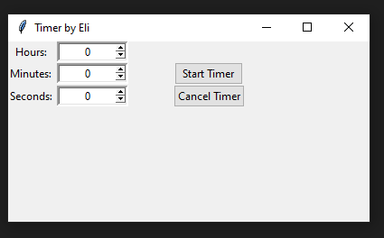
Timer
A basic timer application
Allows you to set time in hours, minutes, and seconds.
Start Timer button starts the timer
Cancel Timer button stops and resets the timer
81 lines of code

Slide 6
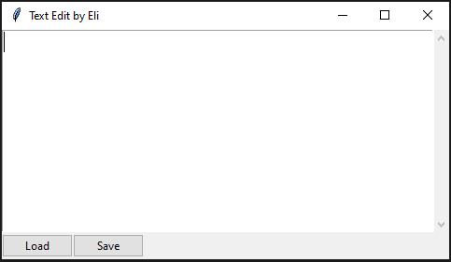
Text Edit
A basic text edit application
Function include
Typing
Saving
Loading
27 lines of code

Slide 7
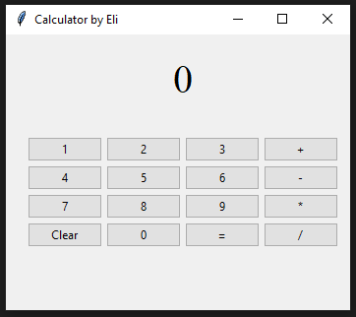
Calculator
A basic calculator application
Functions do not include
Typing decimals
Scientific functions
Multi-operator equations
Keyboard input
Functions do include
Addition
Subtraction
Division
Multiplication
Multi-digit numbers
Clearing
162 lines of code

Slide 8
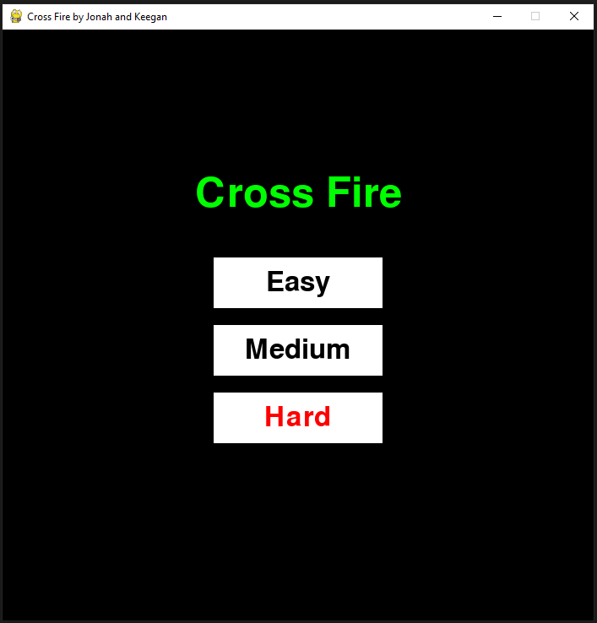
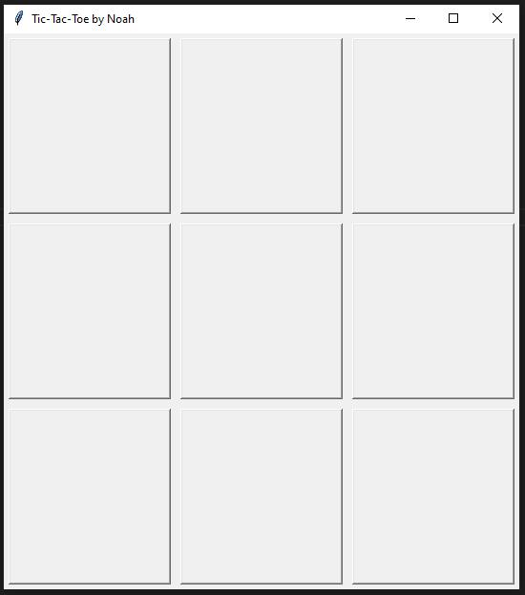
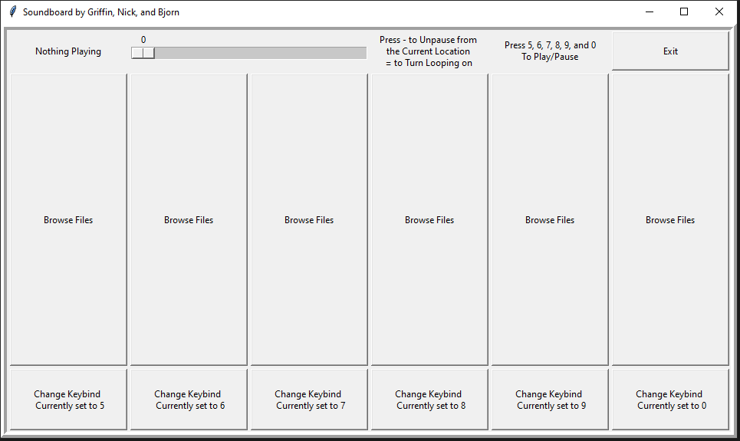
Other Apps
Tic-Tac-Toe made by Noah
Crossfire made by Jonah and Keegan
Soundboard made by Griffin, Nick, and Bjorn

Slide 9
1573
Total Lines of Code

Slide 10
Libraries

Slide 11
Tkinter
Used for GUI
Buttons
Text Labels
File Dialogue
Window

Slide 12
Subprocess and JSON
Subprocess
Used to run apps from main menu
JSON
Used to import app python scripts from JSON file
Used when adding apps to JSON file

Slide 13
Time
Used in Stopwatch and Timer for keeping track of seconds
time.sleep(1)
Waits for one second and then updates a variable

